Slide 1


Using Yelp Business Reviews to Predict Potential Business Attributes
Patrick Critz, Conor McDonough, Christopher Guerrette, Yash Patel

Slide 2


Problem Statement
Can we use yelp reviews to predict if a business has certain binary attributes?
Notes:
Conor- For our project, we wanted to determine if we could predict if a business has certain attributes based on its yelp reviews. This can be helpful if a business has attributes that are not defined. There could be a system that uses review data to suggest potential attributes to users when viewing a business.

Slide 3
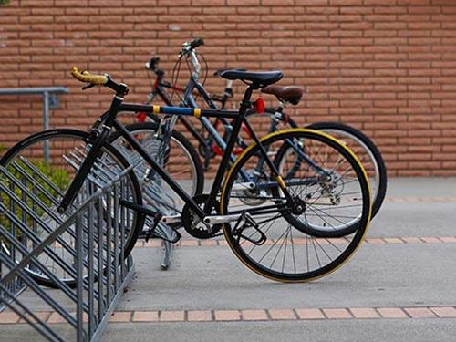

Determining what Attributes to Predict
First list: 7 Attributes
Business Accepts Credit Cards (1/39, 120,177 Businesses)
Bike Parking (4/39, 76,480)
Good for Kids (7/39, 56,850)
Outdoor Seating (9/39, 50,128)
Has TV (13/39, 44,495)
Wheelchair Access (19/39, 29,370)
Dogs Allowed (22/39, 18,308)
Second List: 4 Attributes
Good for Kids
Outdoor Seating
Wheelchair Access
Dogs Allowed
Notes:
Conor- First, we had to determine what attributes we wanted to predict. We looked at all of the attributes and determined what attributes we thought were the most central and important to a business. We created two lists- one with 7 binary attributes and one with 4. We thought having two different sized lists would allow for us to test the extend the model would be able to predict. The original 7 attributes were if a business accepted credit cards, if there is bike parking, if it is good for kids, if there is outdoor seating, if it has a TV, if there is wheelchair access, and if dogs are allowed. For the second list, we have a subset of the original 7 - if the business is good for kids, if there is outdoor seating, if there is wheelchair access, and if dogs are allowed. The rankings to the right of these attributes show how common each of these attributes are. For example, bike parking is the 4th most common attribute among businesses- 75,000 business have it. We can see that these attributes are all someone common among businesses. Once we selected the attributes we wanted to predict, we next had to determine how we would predict them.

Slide 4

Filtering the data
Only take reviews from businesses with a review count of:
For efficiency we created multiple files each member could train/test a different set independently.
At least 1000 reviews
At least 500 reviews
734,055 reviews in dataset
1,756,167 reviews in dataset
Notes:
Patrick- To cut down on the total number of reviews, we decided to filter the reviews and only take the ones from businesses who’s review count met a specified threshold. The first set was businesses with at least 1000 reviews and the second was businesses with at least 500 reviews. We felt that this would help the training process because each business would have a good amount of review data associated with it.

Slide 5
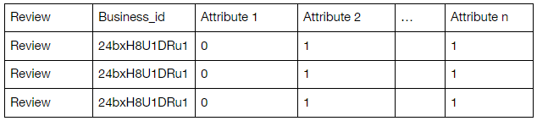
Formatting the Data
In order to make the data python-ready, we took a couple of different actions
Removed unnecessary data
Combined the encoded text and binary attribute values into a csv. file
.json
.csv
Notes:
Patrick - Formatting the data was a very important part in our research process. The current data we had was in a huge json file, but these are very hard to work with in python. We took the data that we needed from it and converted it to a csv file that was delimited by the “bar” character since many of the reviews have commas in them. The table on screen is an example of how our final data sets were constructed.

Slide 6


Formatting the Data cont.
Python is slow and we are all relatively inexperienced with it
Data is already formatted to one review/business per line
Lots of unused data
Wanted to test against different collections of attributes
Ingest program written in C++
Parsing reviews and businesses can be done in O(n) time
Used a bitmask to store attributes on a business
All of the output files can be generated in O(n) time
File size reduction
Notes:
Patrick

Slide 7
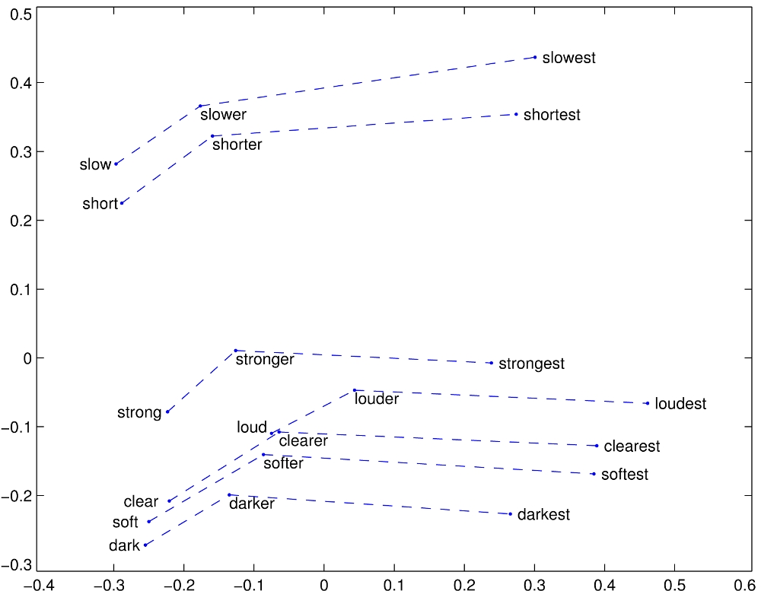
Encoding the Text
To encode the text, we used GloVe
Good at identifying words that are similar semantically
Notes:
Chris - We decided to use Global Vectors for Word Representation (GloVe). There are several reasons why GloVe was chosen to encode the text. One reason is its ability to identify the nearest neighbor of words. GloVe uses the Euclidean distance between two word vectors in order to determine how semantically similar they are. For example, some of the closest words to frog are frogs, toad, litoria, etc. We thought this would be useful when dealing with synonyms of attribute related words. We also removed punctuation and numbers, single characters, and multiple spaces.

Slide 8
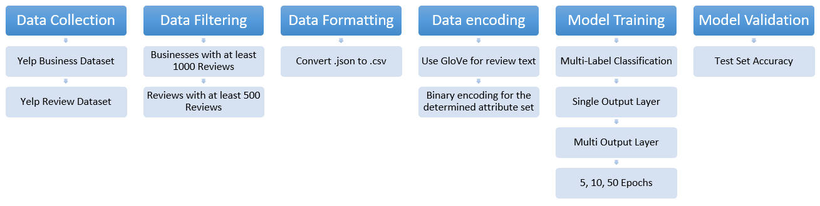
The Model
We performed Multi-Label classification using Keras
Single output and multiple output layers
Created the models multiple times using different epochs
Measured the score and accuracy
Notes:
Yash - We used the Multi-Label classification to check whether the reviews can accurately predict our attributes. The single output layer uses a Dense layer with multiple outputs depending on the attributes. We felt that reviews from the same business would have similar words that are related to the business’ attributes. Our prediction is that using more review data and less attributes would yield the best performance because there would be less classification labels and more data to work with. We ran our model with 5, 10, and 50 epochs for an attempt to get higher accuracy. Glove embedding, 70% training data

Slide 9
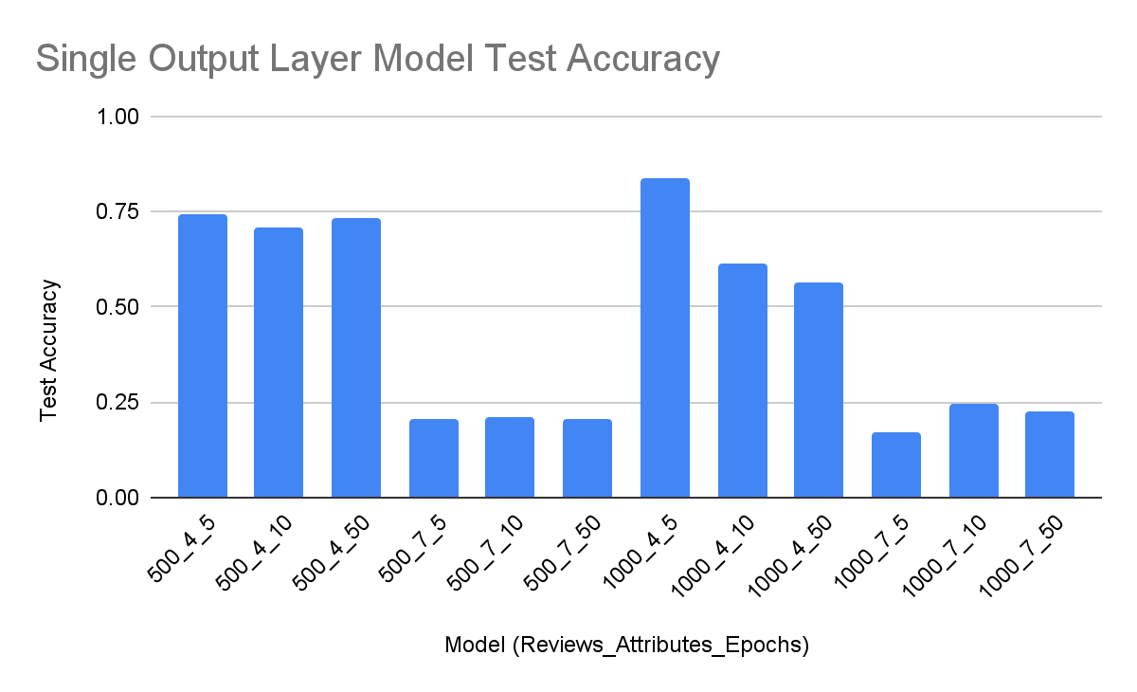
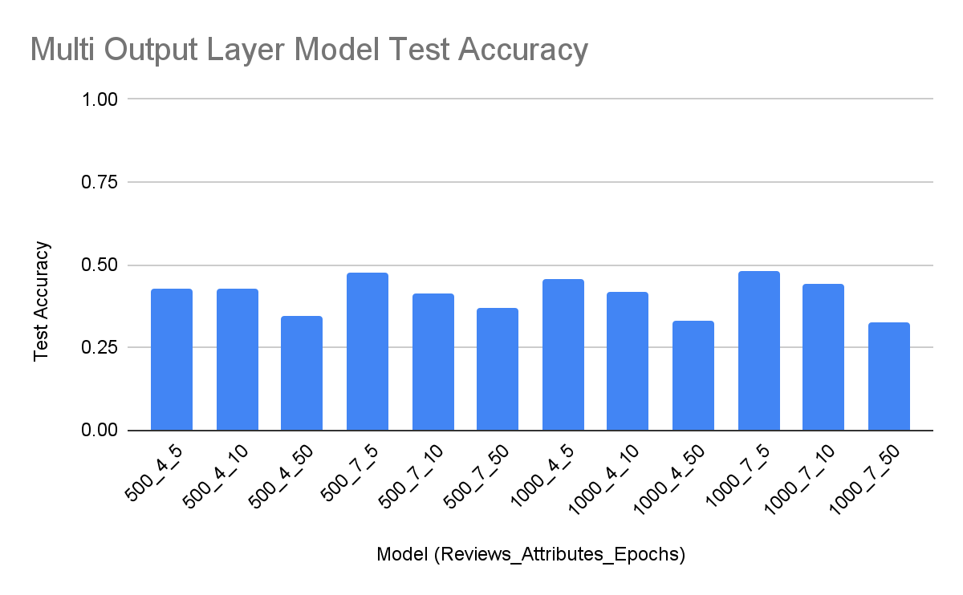
Results
Notes:
Yash - Theses were the results from all of our testing. On the left is the Single Layout output data and the right is the multi layer output data. The X-axis data is organized by the review number filter, the number of attributes, and the number of epochs done. The section that saw the best performance was with predicting 4 attributes rather than the 7. This is something that we anticipated to see but there did not seem to be an advantage to the amount of data we used. We also saw that increasing the number of epochs did not always help the model’s performance. Overall The single output layer model had better performance but the multi output layer model was much more consistent over all the datasets.

Slide 10

The Conclusion. What did we learn?
This is a difficult task to complete that needs a lot of data.
Using different ways to combine the review could be useful.
It is easier to predict less attributes.
Adding more data did not necessarily make the performance better.
Notes:
Chris - So, what did we learn? Well, this task is a lot more complicated than we first anticipated. There are 39 attributes in total and the best we could do was a subset of 4 of them with okay performance. Second, there might be better ways to use the review data. We were using each individual review and associating it with business attributes but we could have also combined all the reviews of a business into one sum of text and dealt with it that way to get a wider interpretation of the data. Finally, throwing more data at the model did really help us out all that much so exploring more ways to represent it could yield better performance.

Slide 11
Thank you for listening!
Are there any questions?
Notes:
Chris - Thank you all for listening to our presentation! Are there any questions?

